Slide 1
The current status and future goals of water supply and sanitation in Azerbaijan
Rashail Ismayilov (Ph.D)
“Azersu” OJSC

Slide 2
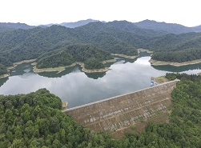
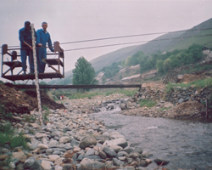
WATER PROBLEMS
In the 21st Century, water security has become one of the strategically important issues for each country, such as energy, food, and transport security.
There are threats to water security in the Republic of Azerbaijan as more than half of its territory is characterized by arid climate conditions.
Thus, estimated population more than 10 million, the local water resources per capita is 1051 m³ per year in Azerbaijan.

Slide 3
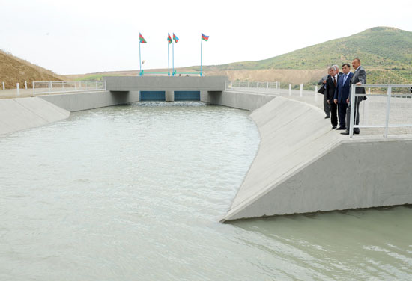
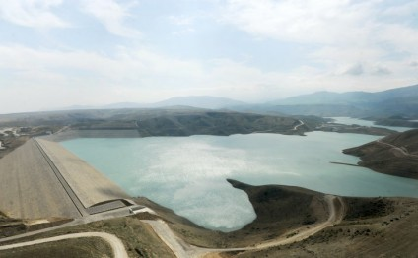
WATER PROBLEMS
According to the forecast of the World Resource Institute, in 2025, Azerbaijan will be among the countries with the lowest local water resources (972 m³/year) per capita.
On the other hand, most of surface water resources (66.7%) accounts for the transboundary rivers and these waters become contaminated in the neighbouring countries, particularly in Armenia and Georgia and flow into the territory of Azerbaijan.

Slide 4
WATER RESOURCES OF AZERBAİJAN AND THEİR USE
Average annual volume of water resources of Azerbaijan
35,3 bln.m³
Annual use of water resources
Annual use of surface water
10,1 bln.m³
Annual use of ground water
1,40 bln.m³
Surface water
30,9 bln.m³
Ground water
4,38 bln.m³
Transboundary water resources- 21 bln.m³

Slide 5
THE LEGISLATIVE FRAMEWORK FOR THE WATER GOVERNANCE IN REPUBLIC OF AZERBAIJAN
Water Code of the Azerbaijan Republic
Law on water supply and waste water
Law on Environmental Protection
Municipal Water Law
Law on security of Hydro-technical facilities and etc.
Law on Earth Interior
Law on Amelioration and Irrigation
In addition, the Cabinet of Ministers has approved rules for use of water, sanitary protection zones, water cadastre and other regulations.
Unlike other countries in the Caucasus, Azerbaijan ratified the convention of UN, on "Protection and Use of Transboundary Watercourses and International Lakes” (Helsinki, 1992)

Slide 6
MAIN PRINCIPALS OF DRİNKİNG WATER SUPPLY STRATEGY OF AZERBAIJAN
I. Provision of each citizen with qualitative potable water
II. Integrated usage of water resources
III. Use of water resources on basin principle

Slide 7
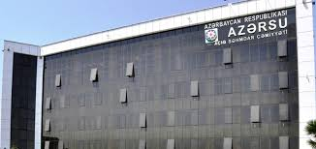
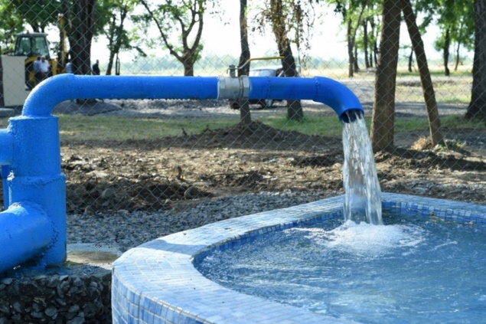
DRINKING WATER SECTOR OF THE REPUBLIC OF AZERBAIJAN
1
Supply the population with quality and sustainable drinking water in accordance with the World Health Organization’s requirements
2
Ensure sustainable use of water resources in the country, increase the water supply and improve wastewater treatment system by enhancing investments made in the water supply infrastructure.

Slide 8
ACTIVITIES ON WATER SUPPLY AND WASTEWATER SECTOR
Taking water from water sources, water treatment and distribution
Centralized drinking water supply consumers
Centralized wastewater services consumers
Designing drinking and wastewater systems
Waste water transportation, treatment

Slide 9
WATER SOURCES AND TREATMENT PLANTS
Shollar- Baku Water Supply Plants Complex
Baku Water Pipeline II
Jeyranbatan water purification plant
Jeyranbatan Ultra- filtration Water Purification Plants
Kura water purification plant
Oghuz- Gabala- Baku Water Pipeline
Kulullu Water- intake Facilities
Shamkirchay Water Treatment Plant
Mingachevir Water Treatment Plant
Khanbulan water purification plant
Guba water purification plant
Module-type water purification facilities

Slide 10
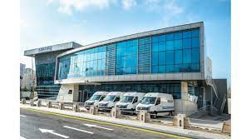
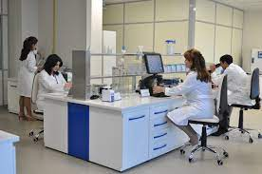
CENTRAL LABORATORY
The building covering an area of 1800 square meters consists of drinking water and sewage sections.
The laboratory is fitted with equipment's manufactured by leading international companies of Germany, France, the USA, Japan, and other countries.
The equipment enables determination of physical, chemical and bacteriological properties of drinking water and makes possible to conduct operative, accurate and reliable analyzes.

Slide 11
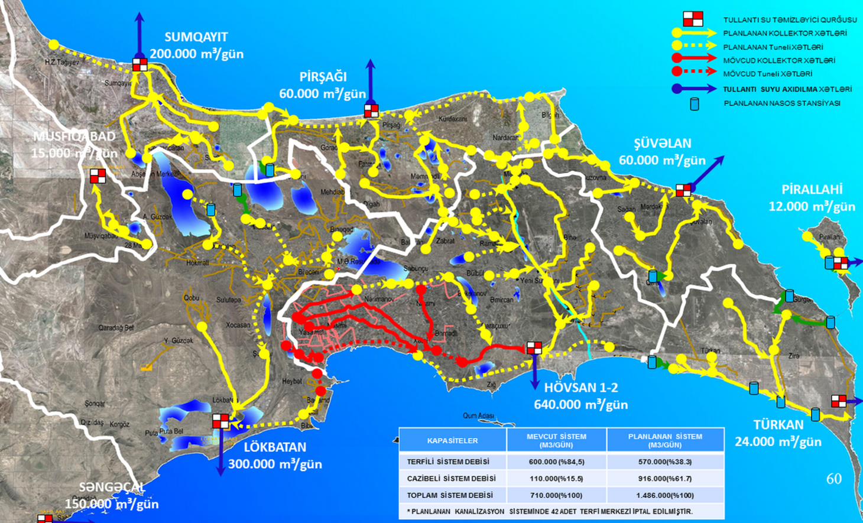
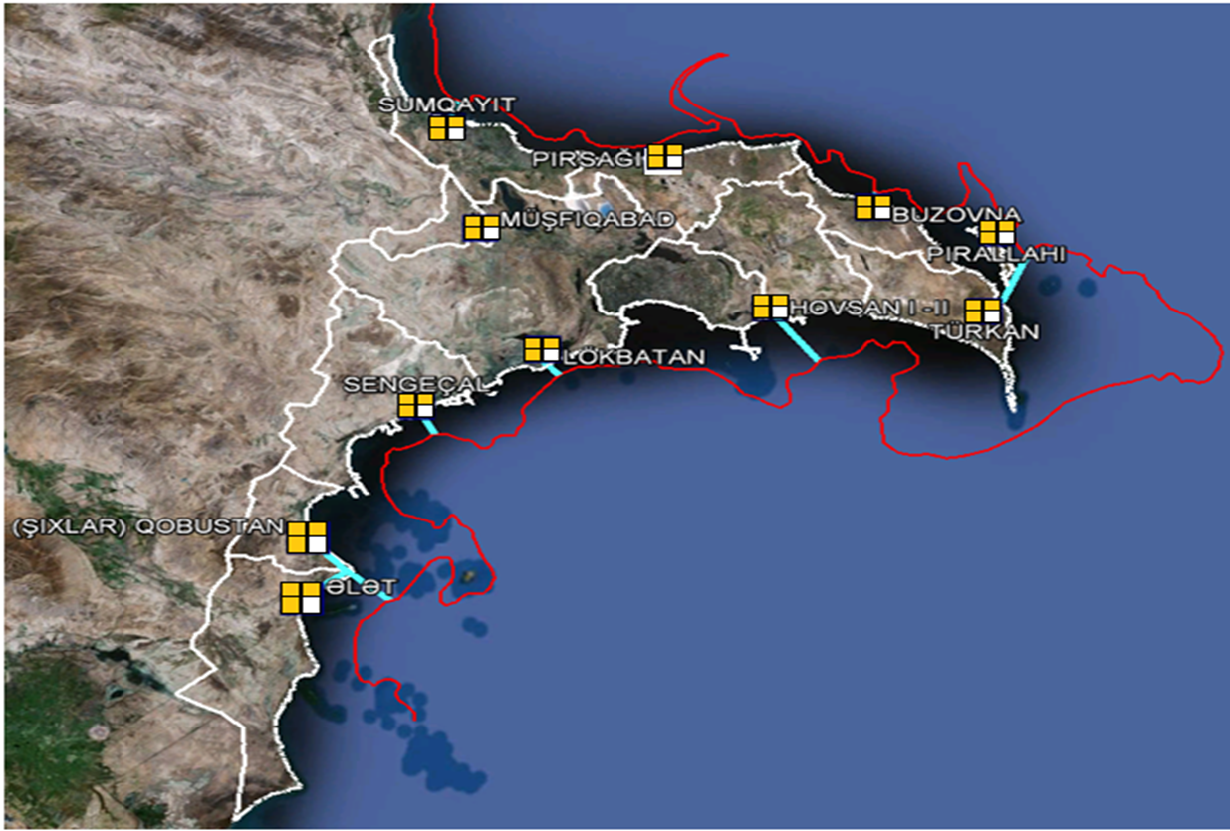
ABSHERON PENİNSULA WATER SUPPLY SYSTEM, SEWERAGE AND STORMWATER MASTER PLAN
Master Plan was prepared with participation of international experts, with the prospect of development for the period as of 2035.
The prospects of urban growth and population density, prospects for the development of tourism, wastewater treatment, and ecological balance were taken as the basis of the Master Plan, which consists of 18 sections.

Slide 12
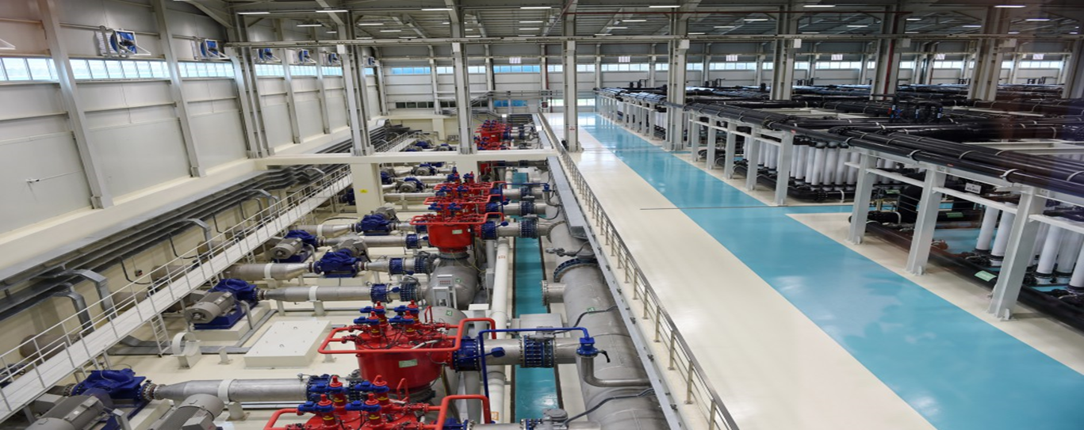
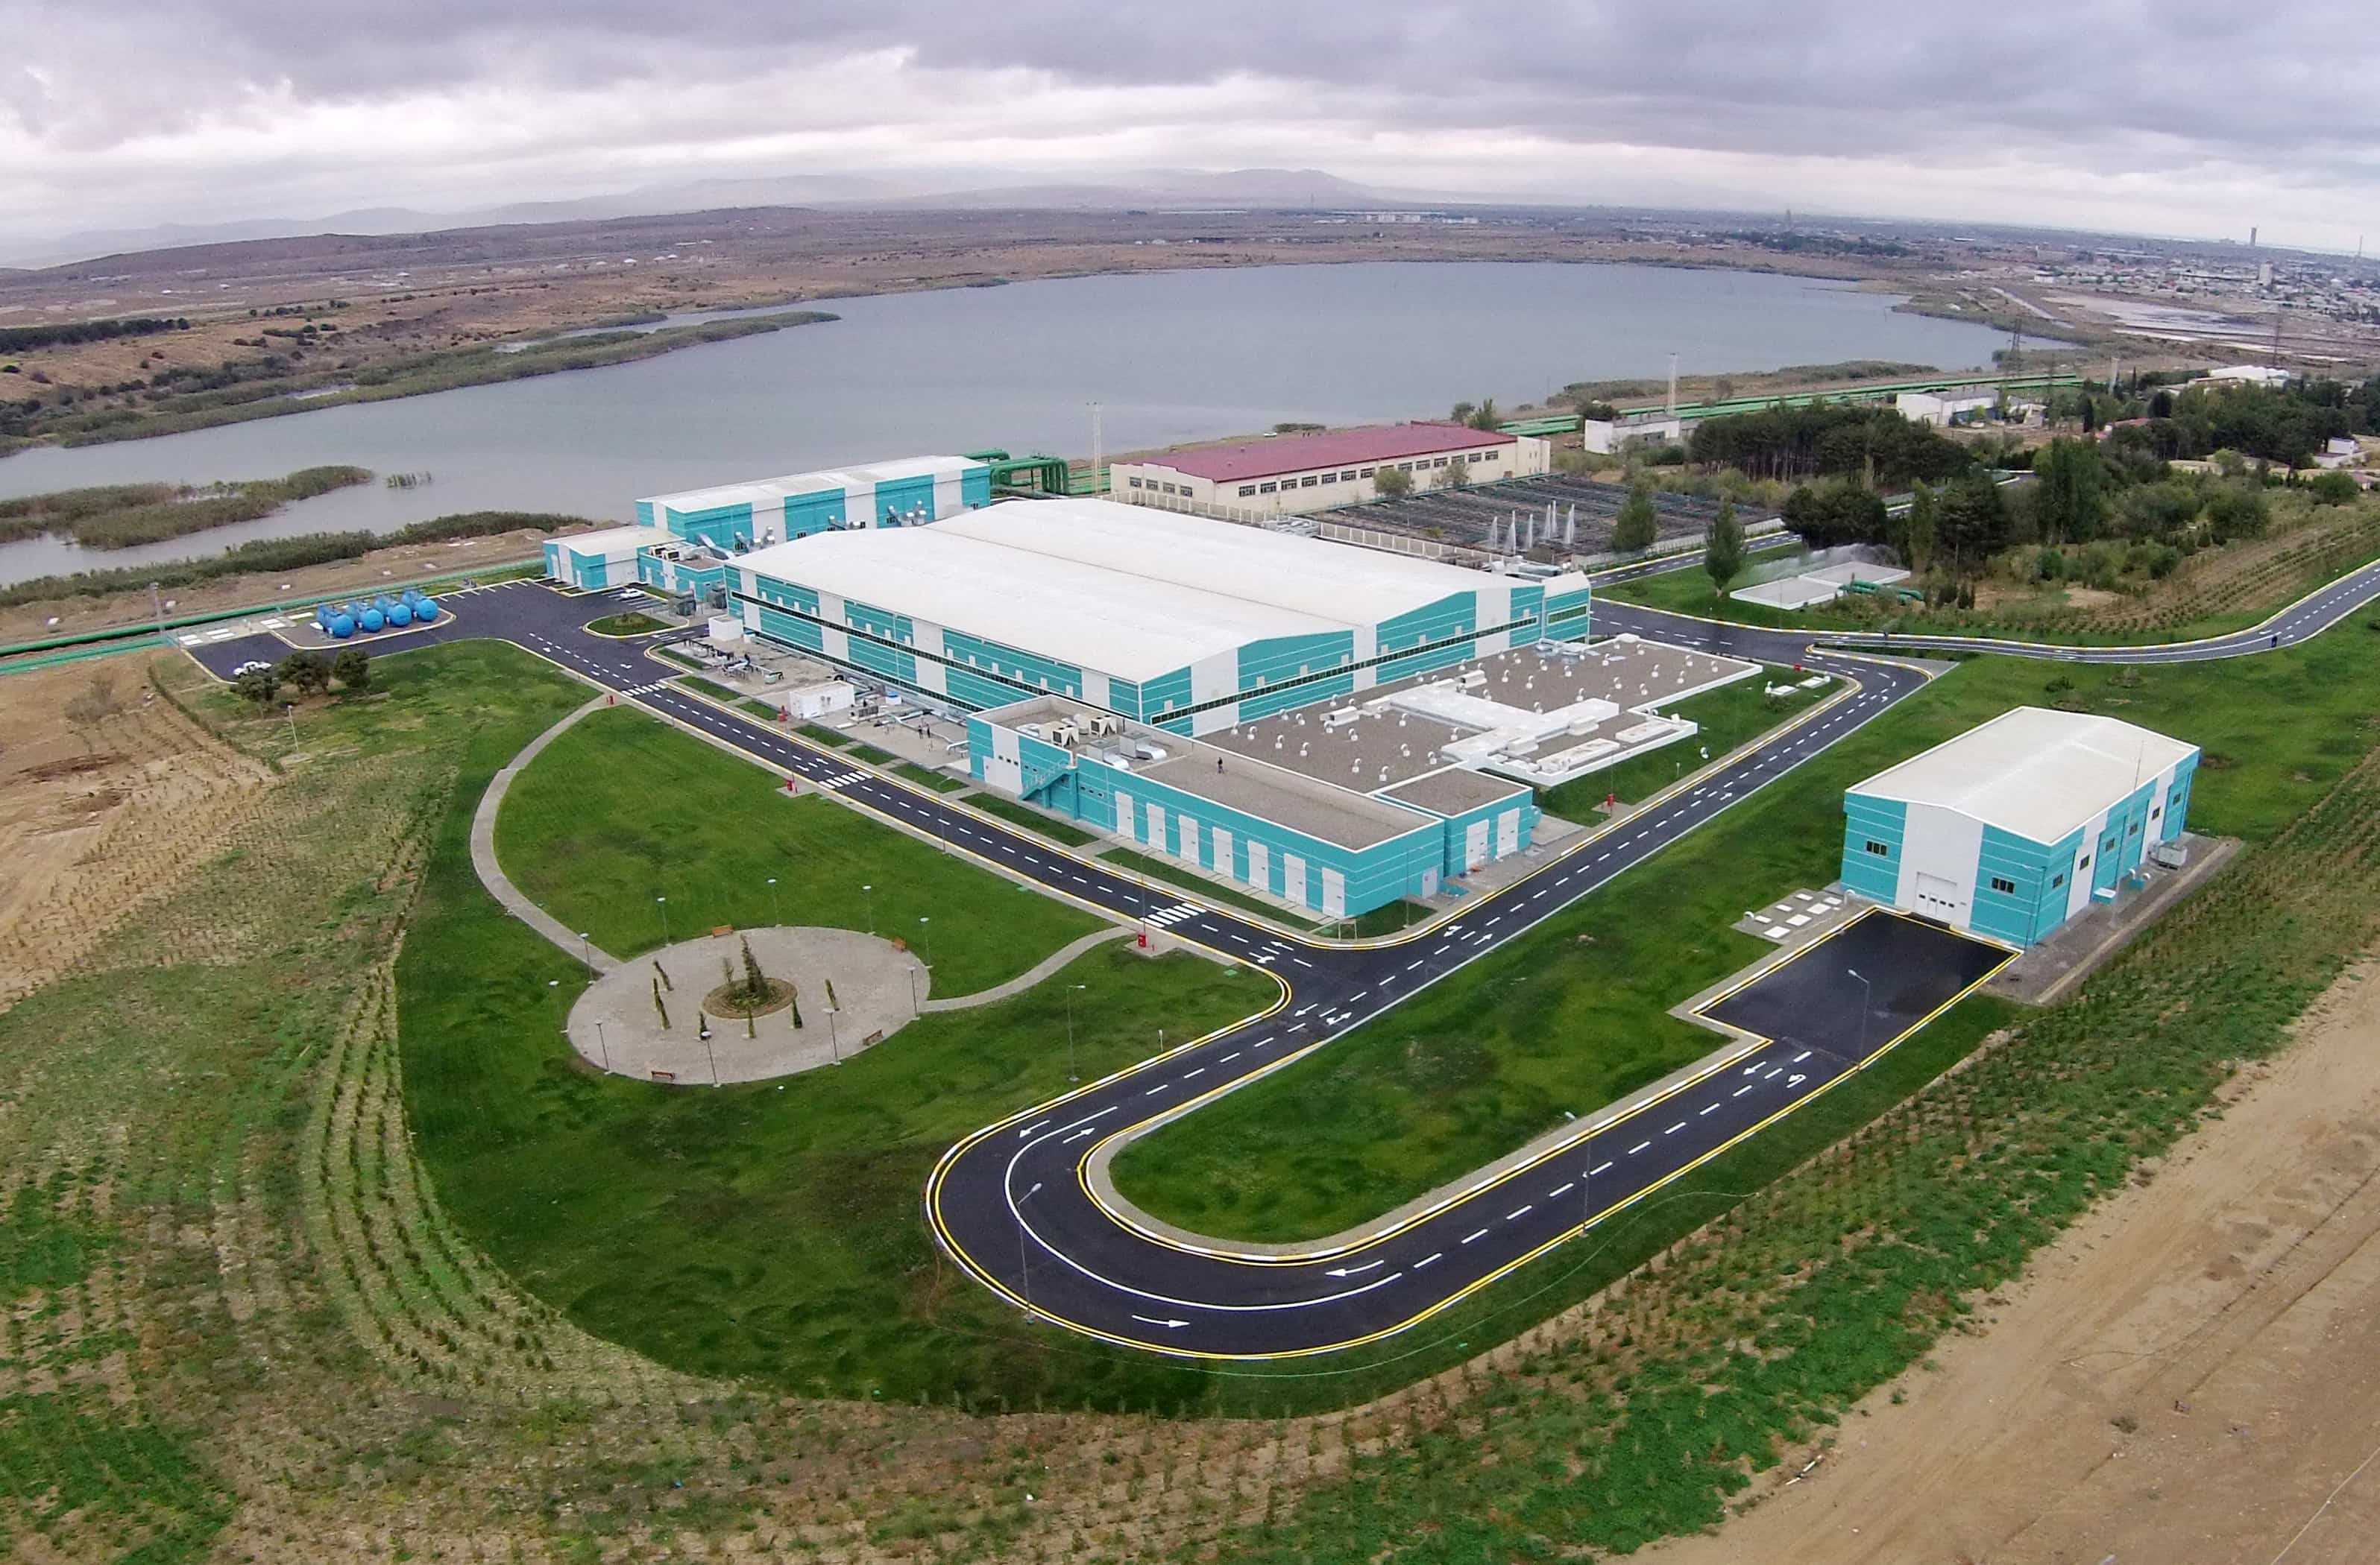
SMART WATER TREATMENT TECHNOLOGIES (Jeyranbatan Ultra-filtration Water Treatment Plants Complex)
Capacity 6.6 m³/s
It is one of the largest facilities of this type in the world
The treatment is carried out with membrane filters
0.02 micron filters are installed in the membranes

Slide 13
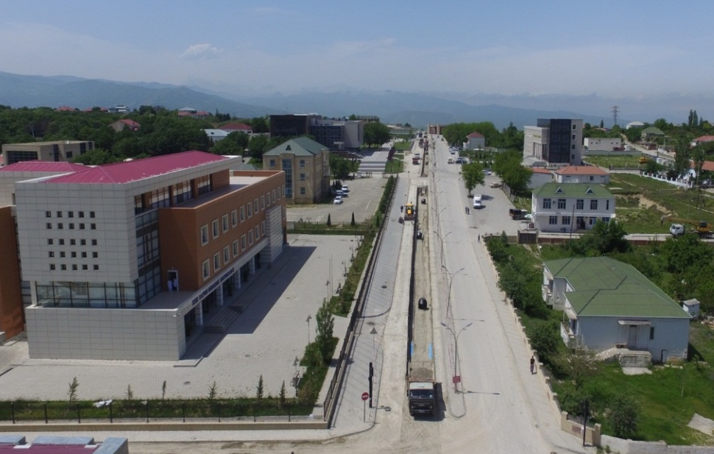
ACTIVITIES ON WATER SUPPLY AND WASTEWATER SECTOR
Service provided cities and regions | 56
The project is in progress | 54
Drinking water and waste water networks completed | 33
Drinking water network completed | 13
"Azersu" OJSC provides services to Baku city and Absheron peninsula, city and district centers of the republic, as well as villages and settlements.

Slide 14
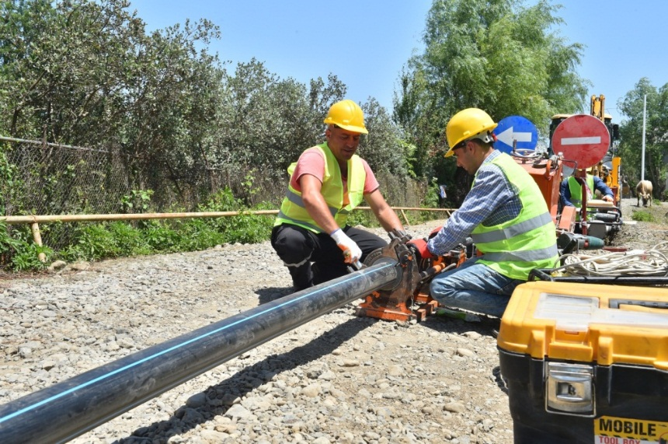
ACTIVITIES ON WATER SUPPLY AND WASTEWATER SECTOR
3316 villages and settlements across the republic
1053 serviced villages and settlements
Drinking water supply of villages and settlements
With a centralized network and private lines – 387
including refugees settlements – 89
springs in common use – 234
modular water purification facilities - 432

Slide 15
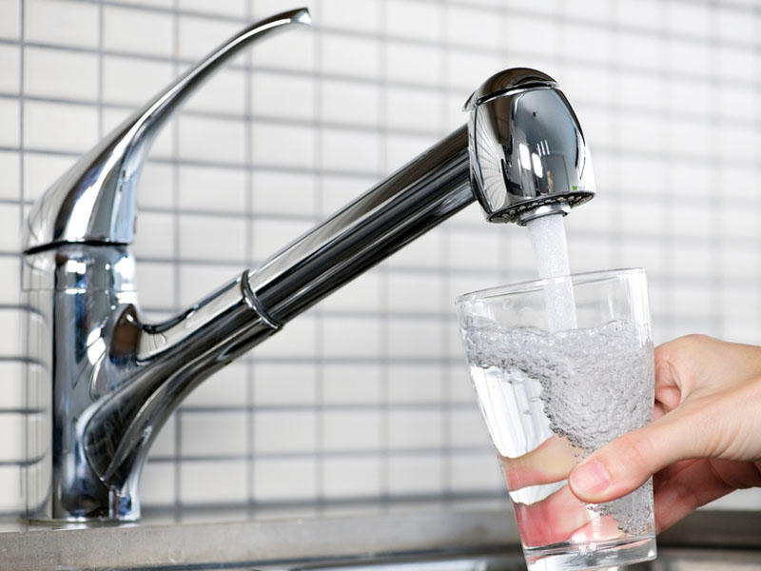
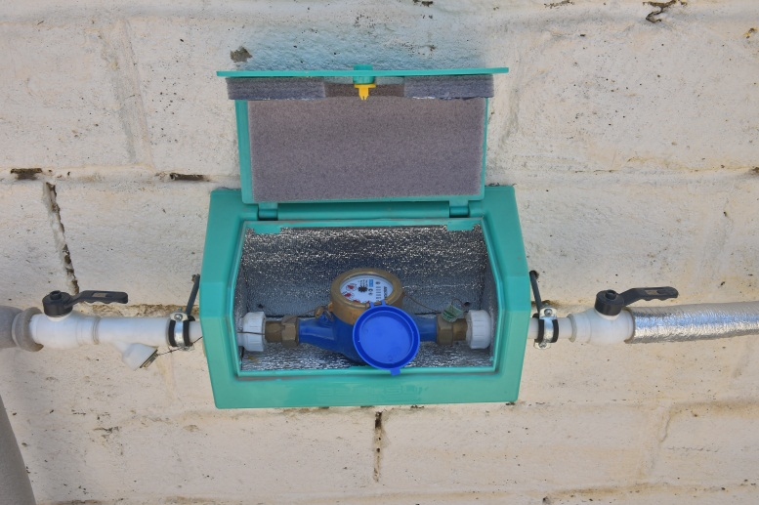
ACTIVITIES ON WATER SUPPLY AND WASTEWATER SECTOR
According to the information as of January 1, 2023, "Azersu" OJSC provides water supply and sewage services to 1 748 832 subscribers across the country.
1 679 880 of them are population and 68 952 are non-population subscribers.
88.8 percent of subscribers are provided with water meters.

Slide 16
ACTIVITIES ON WATER SUPPLY AND WASTEWATER SECTOR
81.7% of subscribers in Baku city are provided with sustainable (non stop) water.
This figure for the country is equal to 78.2%.

Slide 17
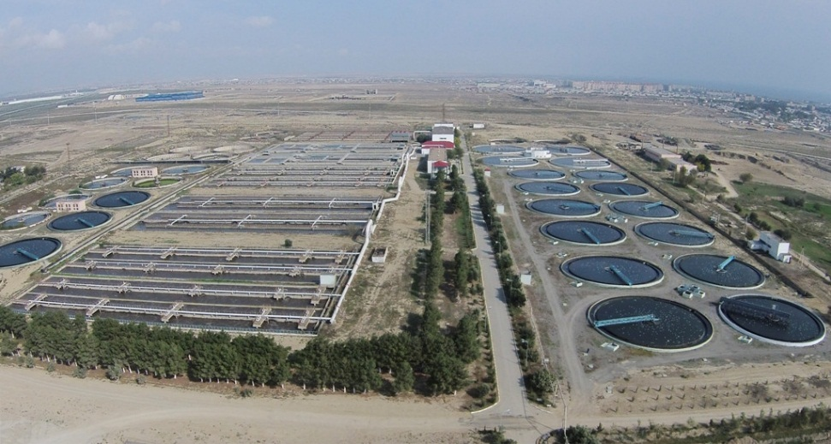
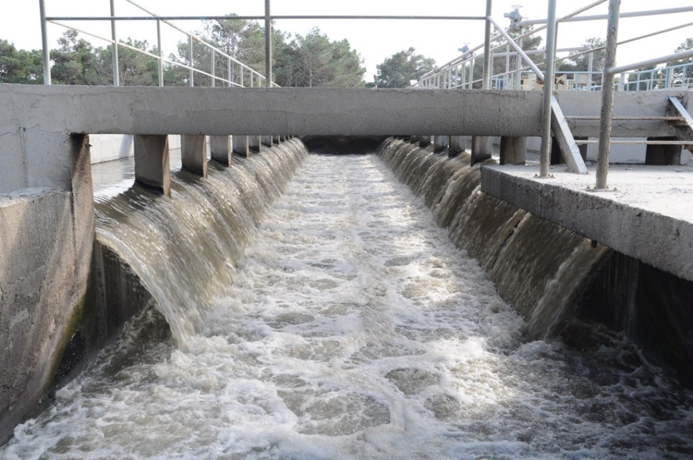
ACTIVITIES ON WATER SUPPLY AND WASTEWATER SECTOR
Wastewater treatment at the Wastewater Treatment Plant is carried out in facilities of various constructions, and they are divided into four groups:
mechanical treatment
biological treatment
neutralization
sludge treatment

Slide 18
ACTIVITIES ON WATER SUPPLY AND WASTEWATER SECTOR
Currently, 33 Wastewater Treatment Plants are operating in Azerbaijan for the treatment and removal of waste water.
5 of them are in the Absheron peninsula, and the remaining 28 are in the regions.

Slide 19
ACTIVITIES ON WATER SUPPLY AND WASTEWATER SECTOR
In 2019, 215 million m³ of wastewater was treated in all Wastewater Treatment Plants across the country.
In 2020, this number increased by approximately 10.14% and amounted to 236.8 million m³.
In 2022, 263,5 million m³ of wastewater was treated in all Wastewater Treatment Plants across the country.
the volume of wastewater treated by mechanical method was 13.7 million m³, and the volume of wastewater treated by biological method was 249.8 million m³

Slide 20
RECONSTRUCTION OF WATER SECTOR
In recent years in Azerbaijan is implemented:
creation and reconstruction of water supply systems in all cities and in most villages
creation and reconstruction of sewerage systems
creation and reconstruction of irrigation and drainage systems
creation and reconstruction of water treatment plants
creation large and small water reservoirs and etc.
The works are realized by Government of Azerbaijan with the financing of investments of:
the World Bank
the Asian Development Bank
the Islamic Development Bank
the KfW Bank of Germany
Sweden’s SECO organization
the Japanese International Cooperation Agency
the Korean International Cooperation Agency
the Saudi Development Fund and other financial institutions

