Slide 1
SMALL AND MEDIUM BUSINESS DEVELOPMENT AGENCY

Slide 2
KOBİA
Strategic Vision
SMEs are leading force in the diversification and development of Azerbaijan’s economy
What we do
Ensuring favorable business environment and protection of SME interests
Access to knowledge, skills and innovations
Access to financial resources
Access to local and international markets
Access to G2B and B2B services
Strategic Goals
GDP
Employment
Non-oil export
Increase share of SMEs in the Economy
Women entrepreneurship
2

Slide 3
INDICATORS
Number of legal entities by criteria
1,393,204
number of individual entrepreneurs
Small 8 298 4.6%
Medium 3 107 1.7%
Micro 149 048 83,4%
Men: 73,5%
Women: 26,5%
Areas of activity:
Trade 32.7%
Other services 40,8%
Construction 12.9%
Industry 13.6%
SMBs
3

Slide 4
IMPROVING SERVICE INFRASTRUCTURE FOR SMES - SME HOUSES
Planning a business
Starting a business
Business plan drafting
Work with startups
Capacity building
Incubation
Registration
Licenses and permits
Seals
Banking, legal, insurance
SME
Houses
are one-stop-shops providing businesses
G2B and B2B services
in operative, transparent and comfort manner.
Running a business
Growing a business
Preparation of reports
Logistics
Contracts
Translation
Bank services
Financing
Export promotion
Investment promotion
Domestic market research
4

Slide 5
SME HOUSES
Khachmaz SME House
Yevlakh SME House
Baku SME House
14
Government and private bodies
24
Service desks
More than
240
Services
14
Government and private bodies
20
Service desks
More than
250
Services
49
Government and private bodies
126
Service desks
More than
250
Services
5

Slide 6
STARTUP DEVELOPMENT CENTER
Baku SME House
First Equipment Sharing based Startup Development Center launched in Baku SME House
İoT
Additive manufacturing
Lasers and optics
Electronics
Cloud Services
İndsutrial design and Prototyping
New material design
49
Government and private bodies
126
Service desks
More than
250
Services
5

Slide 7
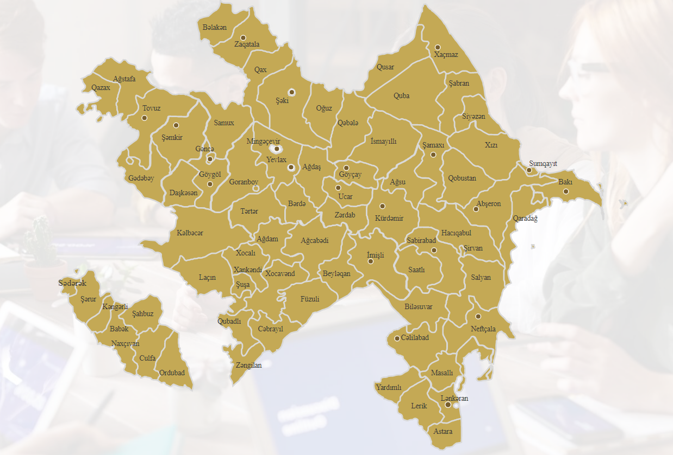
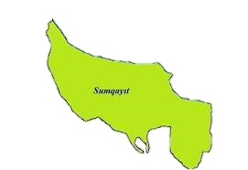
SME FRIENDS NETWORK
42
offices in
38
cities and regions
Support in establishing of new SMBs or expansion of existing ones
Implying protection of SMB rights
Conduct surveys and monitoring
6

Slide 8
SME DEVELOPMENT CENTERS
Training and advisory services
Capacity building for current and potential entrepreneurs:
Business planning
Business development
Marketing
Sales
Business legislation
Financial management
Human resources management, etc.
Online training platform
www.kobim.az
30 000
hours of consulting services
More than
2 300
trainings
23 000
SMEs and startups benefited
1 000
SMEs benefited from 180
training videos
7

Slide 9
SME SUPPORT MECHANISMS
START UP CERTIFICATE
MARKET RESEARCH
91 Applicants granted start up certificates
Decree of the Cabinet of Ministers No. 20 dated 01/29/2021, the support mechanism is implemented by the Agency in accordance with the “Start up Definition Criteria”
26 market researches in the field of food production, textile, machinery, industry etc.
Decree of the President of the Republic of Azerbaijan No. 713 dated may 29, 2019 On the approval of the "Rules for state support of internal market research in order to stimulate competitive products of micro, small and medium-sized businesses.".
INTERNATIONAL EXHIBITIONS
GRANT PROGRAMS
Decree of the Cabinet of Ministers No. 364 of September 30, 2020, On Approval of the “Rules for Financing Education, Science, Research and Support of Projects Related to the Development of Micro, Small and Medium Business”.
40 Projects
More than
700 000 AZN
Financing
KOBİA provided participation of 1250 micro and small businesses on 47 local and international exhibitions
Decree of the President of the Republic of Azerbaijan dated December 1, 2021, On approval
"Procedure for supporting the expansion of sales of micro and small business products in retail chains“.

Slide 10
SME SUPPORT MECHANISMS – SME CLASTERS
BENEFITS
STATE
INVESTOR
Provide tax incentives for SME clusters for join manufacturing and production
Undertake to attract minimum 10 SME companies
12

Slide 11
SME SUPPORT MECHANISMS – Consulting, Company formation and activity support
Successful stories
Establishment and expansion of the tobacco enterprise
Creation of a new tourist complex
Lauching of lavender tea Production facility
Support for launching 15 village guest houses
Trade support at local and foreign exhibitions
Social entrepreneurship projects
KOBIA has supported investments in the regions
13

Slide 12
SME SUPPORT MECHANISMS – Market Access Program
According to this program, KOBIA is renting spaces in the market chains and warehouses and provide it for free for the SMEs
13

Slide 13
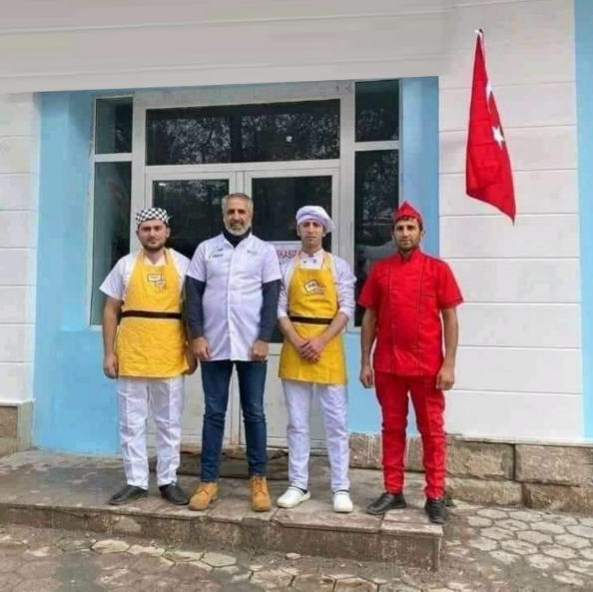
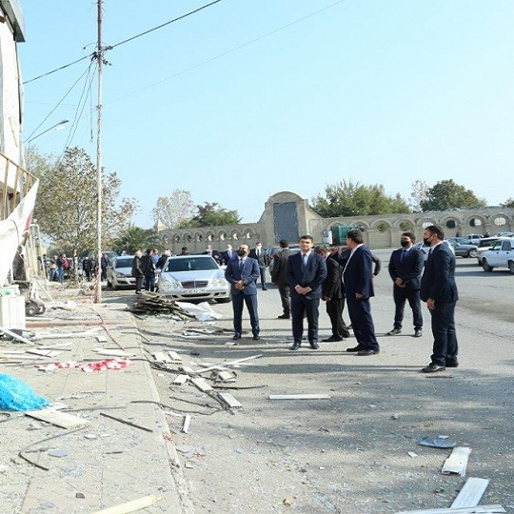
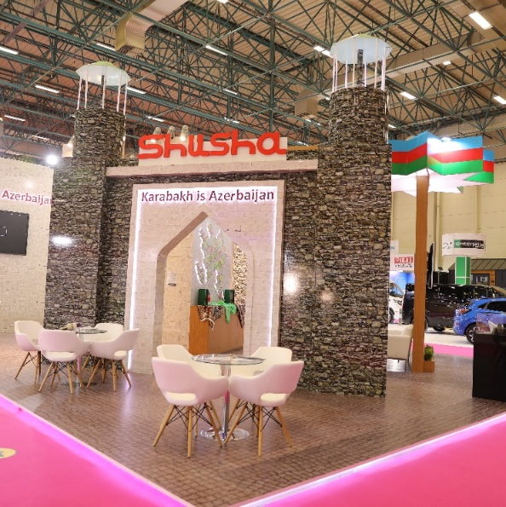
KOBİA’s ACTIVITIES IN LIBERATED AREAS DURING AND AFTER KARABAKH WAR
Around 1400 applications 35% of which are from foreign businesses, representing 35 countries (mostly from Turkey, Russia, Kazakhstan, Hungary)
Organization of entrepreneurial activity, support for attracting local and foreign investments.
Support for social entrepreneurship initiatives.
Support for business access to public services, training and consulting services, concessional financial resources.
3 companies have already started to work in region: medical textile production, souvenir production and bakery
14

Slide 14
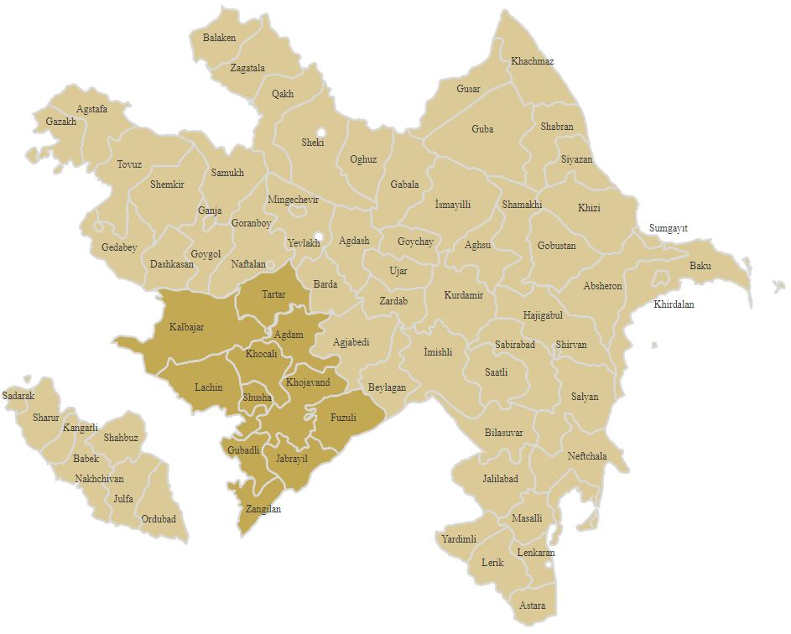
INVESTMENT POTENTIAL OF LIBERATED AREAS
Mineral deposits:
facing and construction stone, lime, clay, freshwater, gold, polymetallic, mercury, sawdust, colored stone, etc.
Economic areas:
cultural, health, recreation and ecotourism, agriculture, heavy, food, and light industries, production of construction materials, horticulture, carpet weaving, etc.
Major agricultural
activities:
Animal husbandry, vegetable growing and gardening, cocoons, cattle breeding, sheep breeding, poultry, potatoes, fruit and grain growing, viticulture, beekeeping, etc.
15

Slide 15
UPCOMING SUPPORTS AND INCENTIVES
FROM One-Stop
to E-SERVICES
The next evolution of public services for SME is a full transition to online digital services. The real infrastructure of the One-Stop services will gradually move to the functions of consulting, events and sharing offices
50% Decree:
According to this law, SME will be pay only half of all penalties and service fees issued and supplied from state bodies.
SME Digital
transformation:
Direct financial support for SME who would like implement digital technologies in business processes and production
50/50:
New pledge and mortgage free financing mechanism
15

Slide 16
THANK YOU!
AZ1000 , Azərbaycan, Bakı,
Üzeyir Hacıbəyli küçəsi, 84 (Hökumət Evi)
Tel.: (+994 12) 493 88 67
Faks: (+994 12) 492 58 95
E- poçt: office@economy.gov.az www .economy.gov.az
AZ1069, Azerbaijan, Baku,
Ziya Bunyadov 38C str.
Tel.: (+994 12) 404 04 01
E-mail: info@smb.gov.az www.smb.gov.az

